Slide 1
SALESFORCE INTEGRATED WITH ALEXA - PERSONAL BOT
SIA Personal Bot

Slide 2
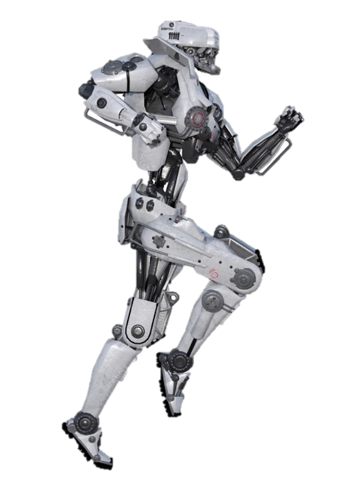
Sia Personal bot
OVERVIEW
Salesforce Integration with Alexa, also known as SIA, is a voice command powered personal bot which helps customers to connect with businesses, using the Salesforce platform for their requests and helps them get quicker responses and enhancing their customer experience.
SIA is here to solve your problems with just a conversation!
No hassle of waiting to get to a customer service executive or having to take the pains of visiting a physical store. You don’t even have to login to an online portal.

Slide 3
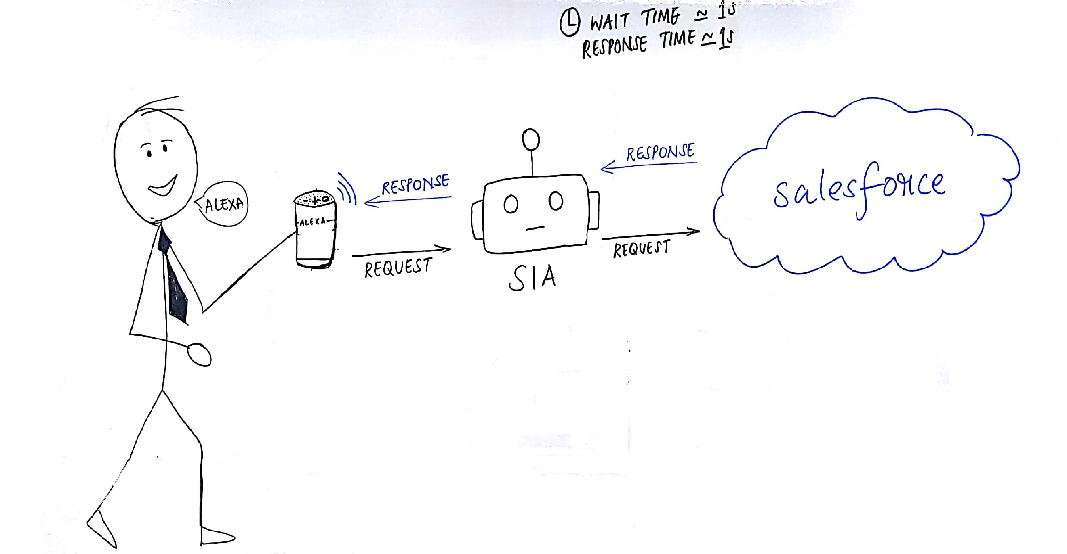
Idea on a page
 | FEATURES OF SIA
Log a Service Request Disconnect Add-on connection Outages Status of existing Service Requests | Change Account Demographic information Information about upcoming outages in the area | Payment reminders

Slide 4


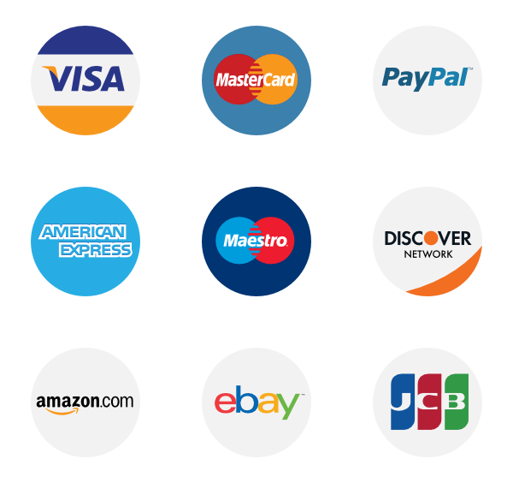

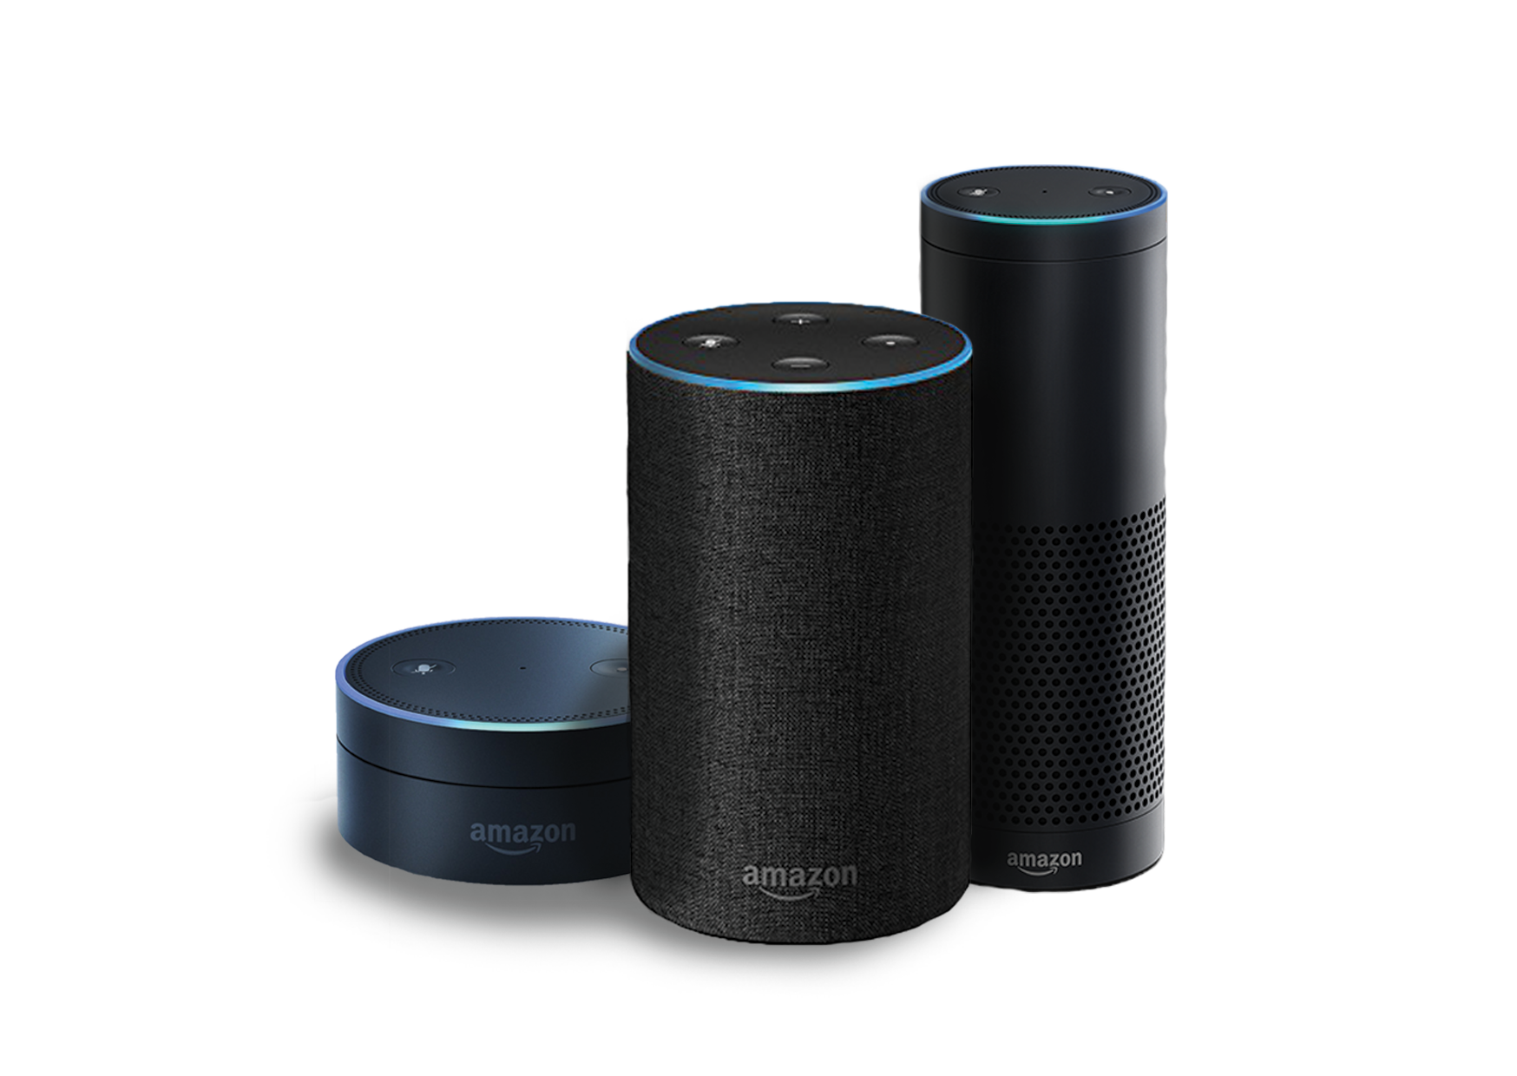

Product roadmap
MVP
Einstein integration
Payment gateway
Service Requests
Integration with alexa

Slide 5
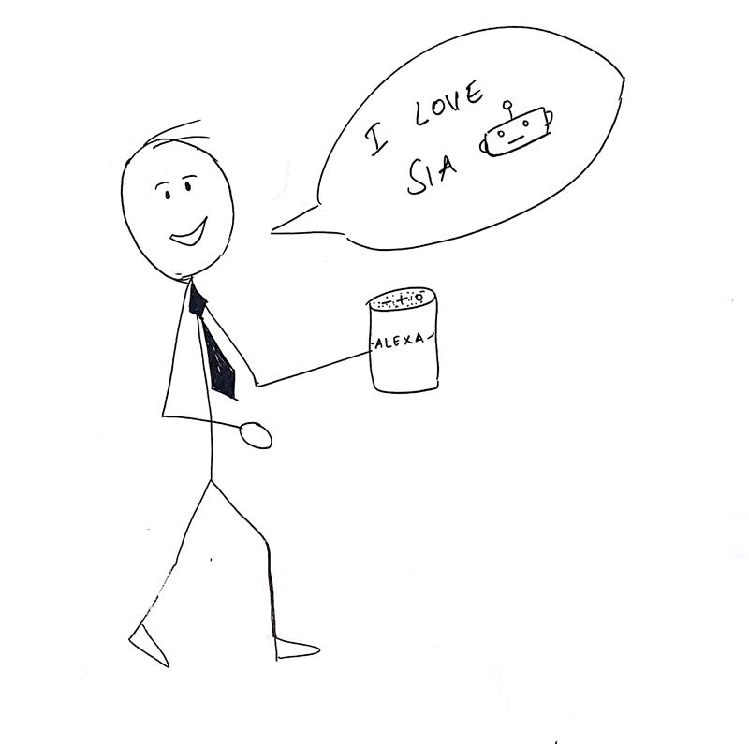






WHAT we plan to Achieve
Better customer engagement
Quicker response time
Integrated platform for customers
Elimination of ivr
Streamlined process
Analyze Customer Problems through EINSTEIN Analytics

Slide 6
Resources
Tools & Technologies
Alexa
Lambda
Salesforce
Python / Java
Payment Gateways
Project Team
BA
SCrum Master
TL/TA

